Slide 1
Creating and Configuring SharePoint Sites
Module 4

Slide 2
Agenda
Logical Architecture
Web Applications
Templates
Site Security

Slide 3
SharePoint Containment
Farm
Web Front End, APP, SQL
Web Applications
Databases
Site Collections
Sites
Lists
Items
Content, Config, SSP, Search
Central Admin, SSP Admin, Content
Servers
Internet, Intranet Portal, Wikis, Blogs, Team, Doc, Mtg
Wikis, Blogs, Team, Doc, Mtg
Doc Lib, Pages, Events, Discussions, Surveys, etc…
Files, calendar items, contacts, customers, images, custom

Slide 4
MOSS Logical Architecture
Farm – Central Administration
Shared Service Provider
Web Application
Site Collection
Site Collection
Web Application
Site Collection
Sub Sites
Sub Sites
Sub Sites

Slide 5
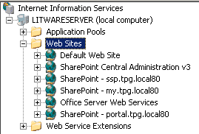
Create Portal Web App
Determine “friendly” URL
Determine account
Determine authentication method
Crucial Terminology: Web Application = IIS Web Site or IIS Virtual Server

Slide 6
More Web App
New web app = new content database
Web App’s can not share databases
DB is default location of new site collections
Want SSL?
Manually configure through IIS
Don’t forget Alternate Access Mappings (AAM)

Slide 7
What is AAM?
Maps incoming request to Web Apps
Then tells SharePoint what URL to respond with
Crucial in reverse proxy scenarios
Very common source of support calls
Search results link to wrong URL
User redirected to different URL on login

Slide 8
Creating your first Site Collection
Why are they important?
Separation of security
Level of ownership
Administration
Can have quotas
Smallest unit for controlling storage database
Sharing between sites confined to
Level of backup

Slide 9
Assign a template
Site Collection is just a container
Needs to have a template applied
Different SKUs = Different OOTB Templates

Slide 10
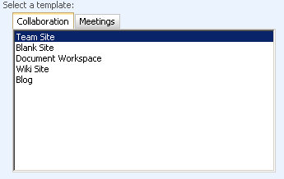
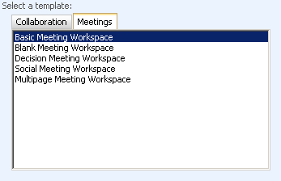
WSS Templates

Slide 11
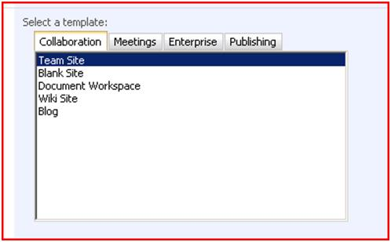
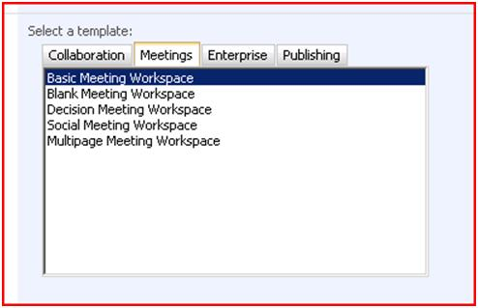
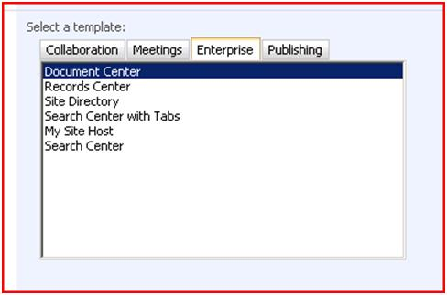
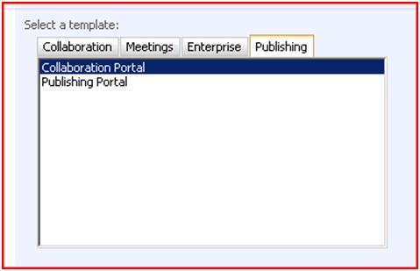
MOSS Standard Templates

Slide 12
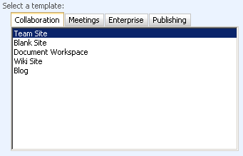
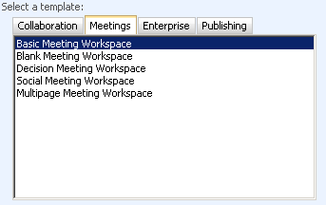
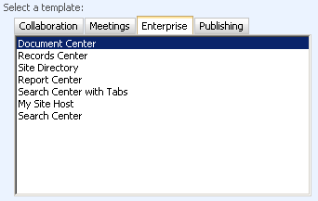
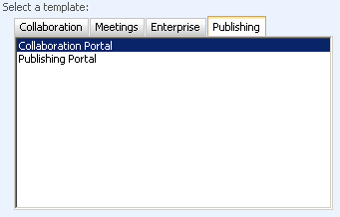
MOSS Enterprise Templates

Slide 13
Getting Started
Intranet/Portal = Collaboration Portal
Internet Site = Publishing Portal
Project/Department Work Site = Team Site
Not required just the usual choices

Slide 14
The Collaboration Portal
Great for those intranets
Many readers/few contributors
Publishing features great for static slow to change sites
Search center is ready to go
Built-in Web Parts focused on targeting and ease of use

Slide 15
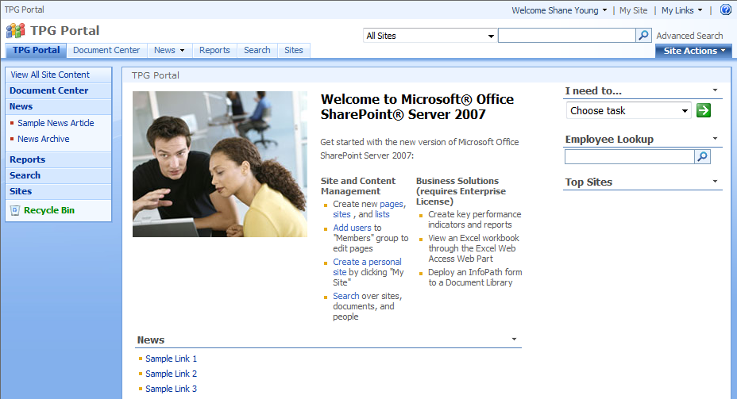
Demo!
Tour of collaboration portal

Slide 16
Publishing Portal
Starting place for building lots of pages
Publishing features put you in control of content
Has approval workflow setup on pages
Add your custom master page and ready to go

Slide 17
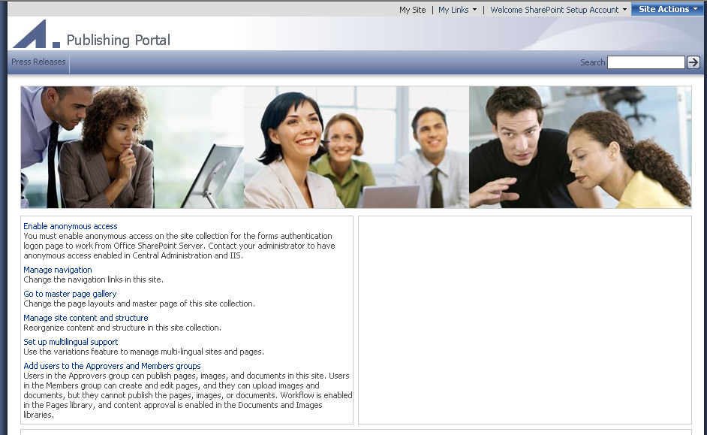
Demo!
Tour of publishing portal

Slide 18
Team Site
Start collaborating now
Edit the page, see the results
Ready for lots of contributors

Slide 19
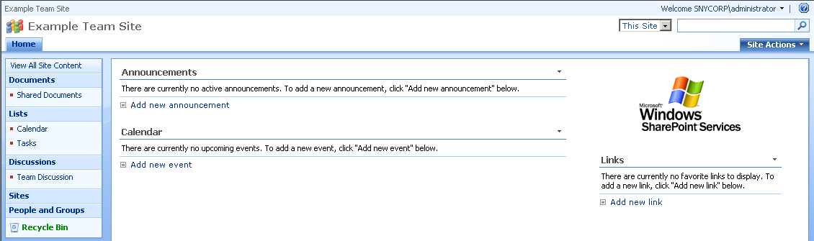
Demo!
Tour of team site

Slide 20
Site Security
Can be broad or granular
Inheriting permissions makes admin life easy
Granted by applying permission levels to groups
Can use AD groups directly
Can use SharePoint Groups
AD groups can be assigned to SP groups
Can assign permissions directly to an AD user
BAD! Management nightmare

Slide 21
Permission Levels
9 available OOTB (MOSS) 5 (WSS)
Set default list permissions
Set site and personalization permissions not available otherwise
Don’t modify instead create your own

Slide 22
SharePoint Groups
3 main groups to consider
Owners – Can do everything on the site
Member – Can add/edit/delete in existing list
Visitors – Read access only

Slide 23
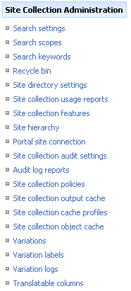
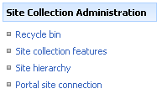
Site Collection Administrators
Separate group for full control of the entire collection
Site Collection Owners automatically added
Special administrative menu
Team Site Collection
Collab Portal Collection

Slide 24
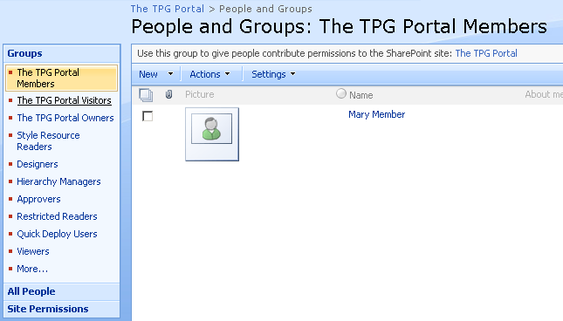
Demo!
Security walk through time

